Slide 1
Housing Dataset
Exploratory Data Analysis
Name : Mohan Prabhu D
Branch : Data Science
Batch Number : 1
Mode of Study : Offline
Roll Number : 150324CBR003

Slide 2
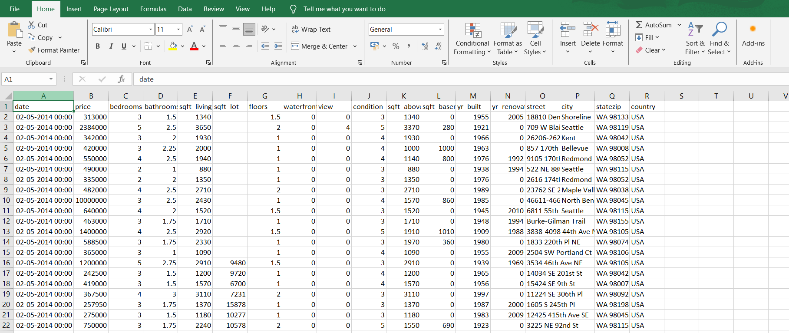
Introduction of the project
The purpose of this project is to perform an Exploratory Data Analysis (EDA) on housing Dataset to uncover underlying patterns, relationships, and insights. A housing dataset typically contains information about their features such as Location Details that contains Address, City, Zip Code, and various properties, including Bedrooms, Bathrooms, Square Footage, Lot Size, Year Built. Such datasets are widely used in real estate analysis, housing market studies, and machine learning applications for predictive modelling.

Slide 3
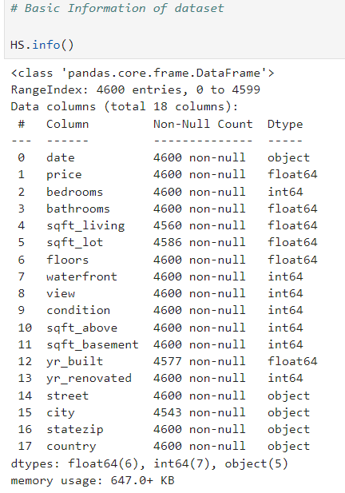
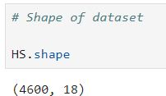
Data Understanding
The dataset contains of 4600 rows and 18 columns.
The key variables include
• Price
• Bedrooms
• Bathrooms
• Sqft_living
• Sqft_lot
• Floors
• Condition
• Year Built
• City
Data Types
• Object
• Float
• Int

Slide 4
Initial Exploration
Accurate property valuation is crucial for buyers, sellers, real estate agents, and investors. Traditional methods of property valuation can be time-consuming and subjective, while the buyers need to know the Location Details such as Address, City, Zip Code, and various properties of the house, including Bedrooms, Bathrooms, Square Footage, Lot Size, Year Built.

Slide 5
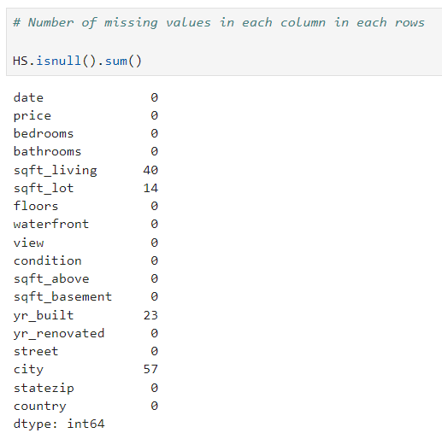



Handling Missing values
Imputing missing values using mean and mode method:
There are a greater number of missing values in columns Sqft_living, Sqft_lot, year built and city, imputing it using the mean and mode method.
The shape of dataset after handling missing values is 4600 rows and 18 columns

Slide 6
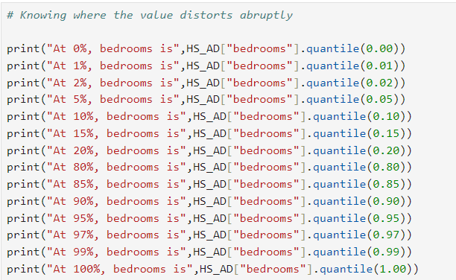
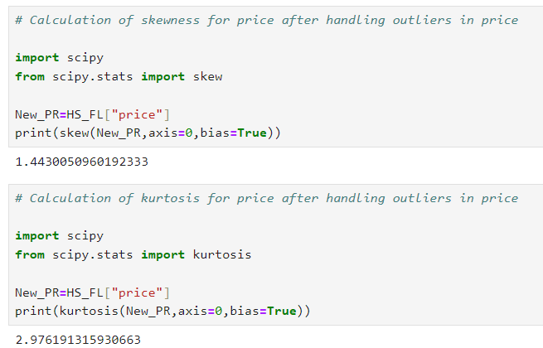
Outliers Handling
Identifying and treating outliers using quantile method:
Treating the outliers in the column’s bedrooms, bathrooms, sqft_living, sqft_lot, sqft_above, sqft_basement and price using the quantile method
Handling outliers in price column using skewness and kurtosis

Slide 7
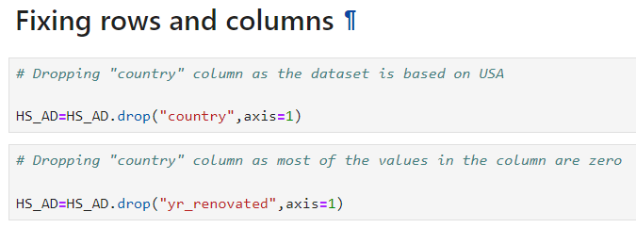
Fixing rows and columns
• Dropping unwanted columns;
There is a column time and country which is not necessary for the analysis. So, removing it.

Slide 8
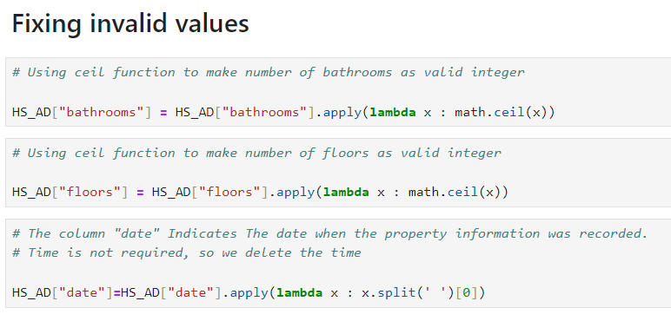
Handling invalid values
Replacing the inconsistent address:
There is inconsistent address in the column street. So, removing the inconsistent address and regularizing the spellings in the address.
Fixing the invalid values:
There are invalid float values in the column floor and bathrooms. So, regularizing the values of floors and bathrooms using ceil method

Slide 9
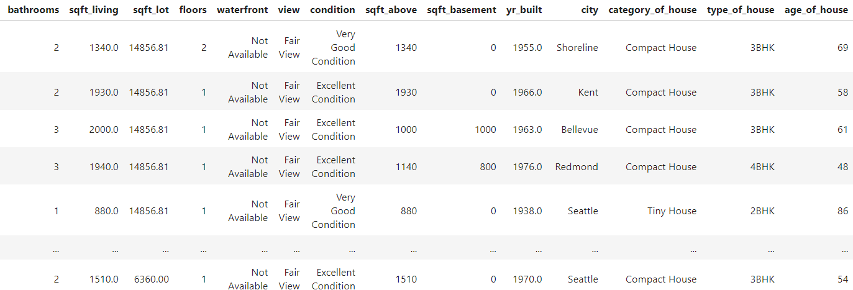
Derived Metrices
Extracted three new columns such as “category_of_house” based on sqft_living and “type_of_house” based on bedrooms and finally “age_of_house” from the column year_built to get the overall insight.

Slide 10
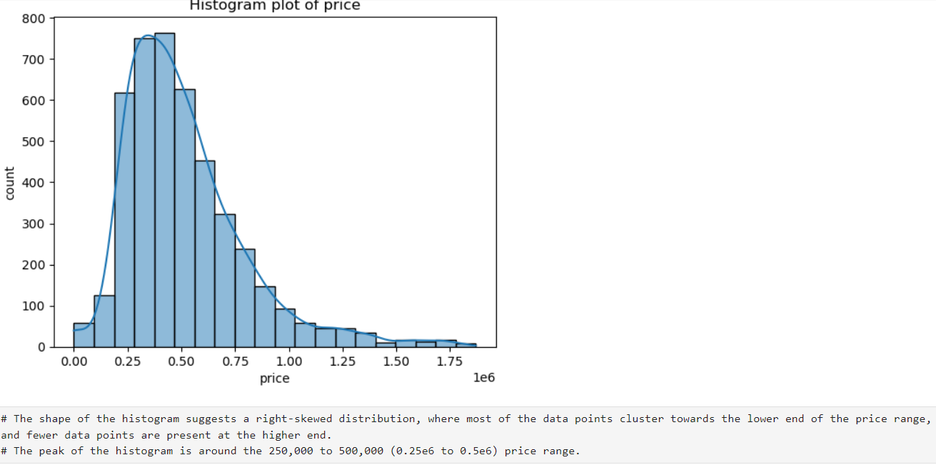
Insights
EDA - Univariate Analysis
1.House Price:
From the skewness value, it is confirmed that it is a right skewed distribution and it is longer on the right side of its peak than on its left side. It is also called as positive skew. It indicates that there are observations at one end of the extreme ends of the distribution, but they are relatively infrequent. A right skewed distribution has a long tail on its right side.
From the above kurtosis value, it is found that we have obtained a leptokurtic distribution. Leptokurtic distributions are more kurtotic than a normal distribution. In Leptokurtic distributions there is a greater tendency for outliers

Slide 11
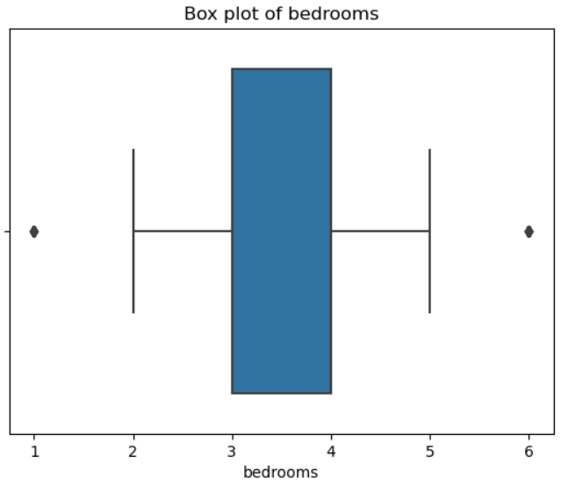
Insights
Univariate Analysis
2.Bedrooms of house:
Most of the data points (middle 50%) are concentrated between 3 and 4 bedrooms.
The distribution is relatively symmetrical around the median.
The plot suggests that most properties have between 2 and 5 bedrooms, there are some properties with only 1 bedroom and some with up to 6 bedrooms.

Slide 12
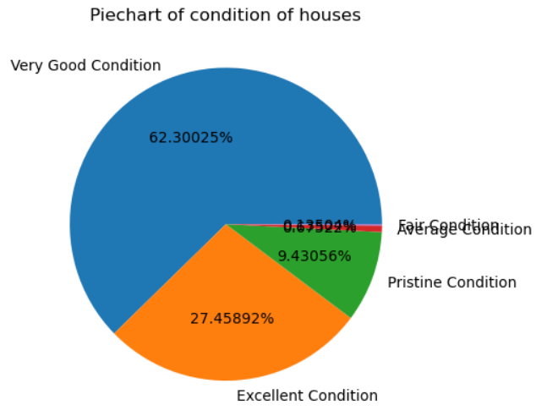
Insights
Univariate Analysis
3. Bathrooms of houses:
Most of the data points (middle 50%) are concentrated between 1.5 and 3 bathrooms.
The distribution shows a slight positive skew, with a few properties having significantly more bathrooms than the majority.
4. Condition of houses:
This plot shows the conditions of number of houses.
Maximum of the houses are in very good condition.
only few houses are in average and fair condition

Slide 13
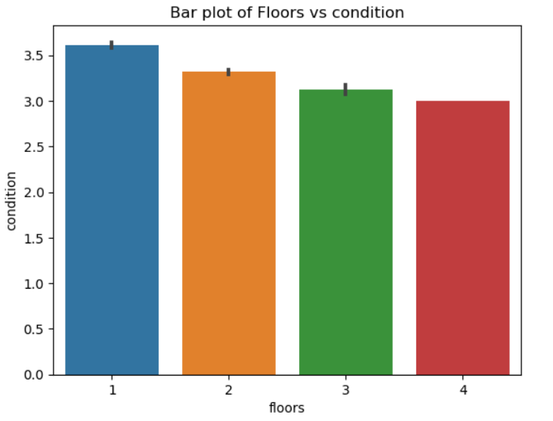
Insights
Bivariate Analysis
1.’Floors’ vs ‘condition’:
Comparing the floors and condition of houses.
Inference:
The chi-square test is used to analyse the relation between floors, conditions of the houses in the city.
It says that the floors are more correlated with the city.
It shows that the houses with single floors are well maintained and good in condition.
When the floors of the house increase the condition is affected

Slide 14
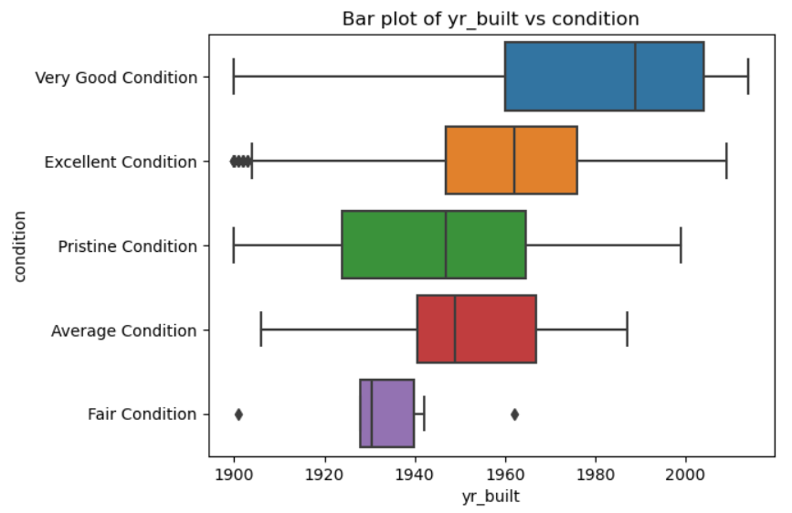
Insights
Bivariate Analysis
2.’year_built’ vs ‘Price’:
Comparing the prices and year built of the houses,
Inference:
The anova test is used to analyse the relation between price,year built and condition of the houses in the city.
It says that the year built is more correlated with the condition.

Slide 15
Insights
Multivariate Analysis
1.Analysis to determine the condition of the house:
Comparing the relationship between the features to determine the condition of the house.
Inference:
The test indicates that the features bathrooms and floors determine the condition of the houses.

Slide 16
Insights
Multivariate Analysis
3.Analysis to determine the waterfront of the house:
Comparing the relationship between the features to determine the waterfront of the house.
Inference:
The test indicates that the price of house determines whether the house has waterfront or not.

Slide 17
Insights
Multivariate Analysis
2.Analysis to determine the view of the house:
Comparing the relationship between the features to determine the view of the house.
Inference:
The test indicates that the price of house determines the view of the houses.

Slide 18
Overall insights
Based on the inferences drawn from your data exploration and visualization, here's a detailed analysis and interpretation of the findings, along with recommendations for the housing data:
Analysis and Interpretation
Key Factors Influencing House Pricing:
Number of bedrooms:
- Houses with bedrooms 2 to 5 are more popular and clients like to have at least 2 or more number of bedrooms in their house.
2. Number of bathrooms:
- Houses with bedrooms 2 to 3 are more popular and clients like to have at least 2 or more number of bathrooms in their house depending on the number of bedrooms.

Slide 19
Overall insights
3. Condition of houses:
- Clients likes the house to be in well maintained good condition. Houses with one floor are well maintained.
4. Distribution of houses in city:
- The data shows that the distribution of houses in the city is based on the number of floors

Slide 20
Recommendations
Number of bedrooms:
- In future there will be no more requirement of more bedrooms in the houses. 4 or 5 number of bedrooms will be sufficient. If there are a greater number of bedrooms then price will be high so it will not attract the clients.
2. Condition of the house:
- Consider to renovate the house at certain period of time and always ensure that houses are well maintained and they are in ready to occupy condition. Then it will attract more number of clients.

Slide 21
Conclusion
In conclusion, a multifaceted analysis of the housing dataset underscores the intricate interplay of various factors driving property prices. While location remains paramount, factors such as property size, condition, market trends, amenities, and economic indicators collectively shape the pricing landscape. By understanding these dynamics, stakeholders can make informed decisions regarding property investments, pricing strategies, and market positioning

Slide 22


